Slide 2
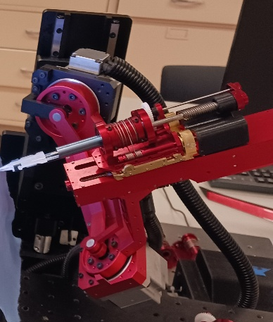
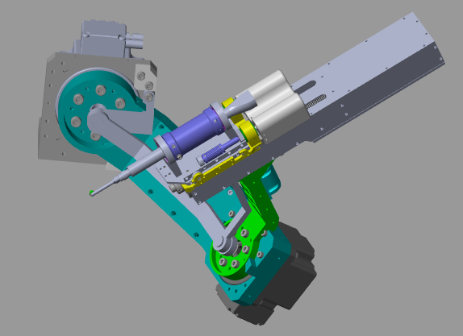







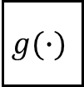



$$K_{d}$$
$$q_{d}$$
$$\tilde{q}$$
$$K_{p}$$
$$−$$
$$u$$
Manipulator
$$\dot{q}$$
$$q$$
$$−$$
$$+$$
$$g(∙)$$

Slide 3
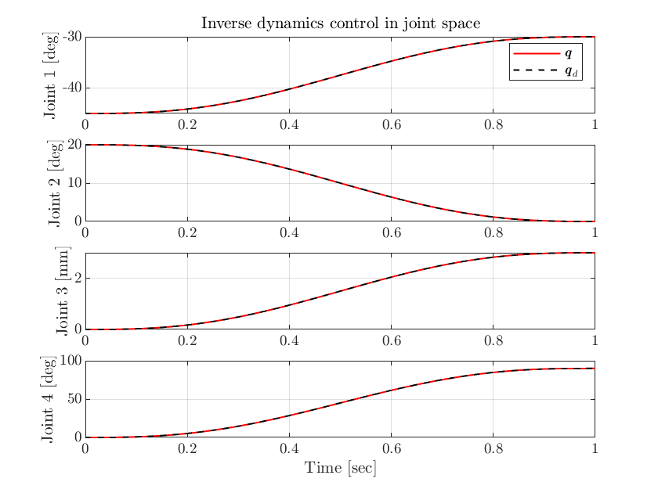
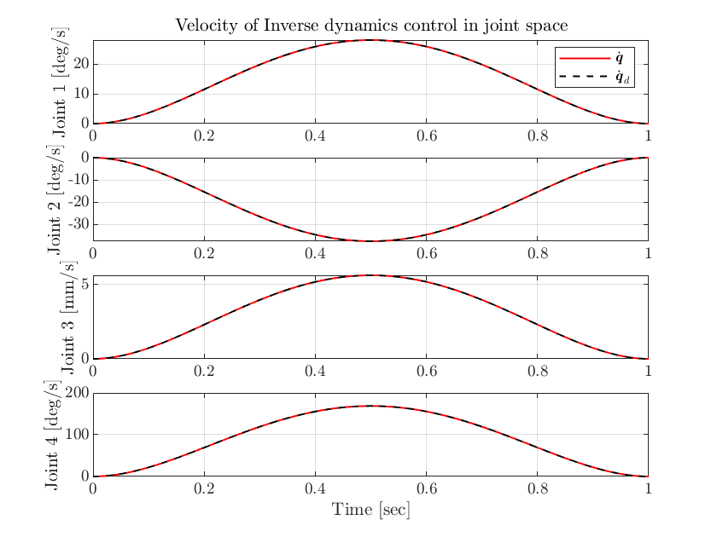
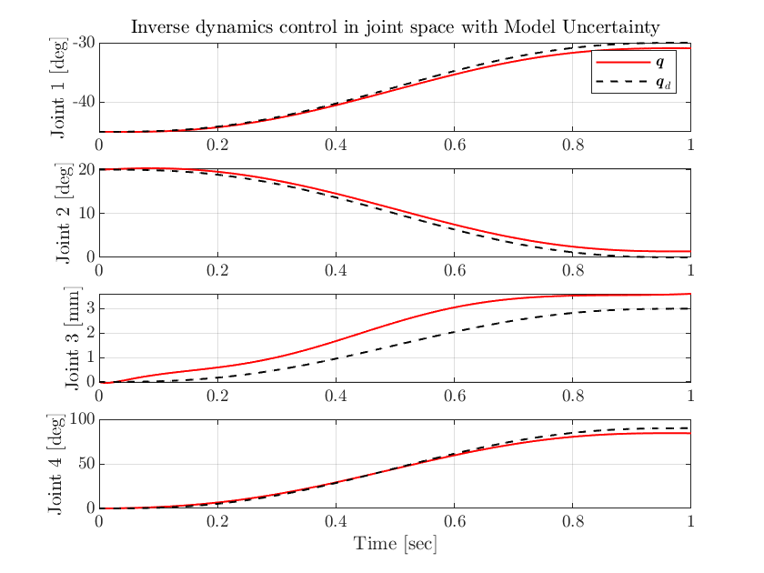
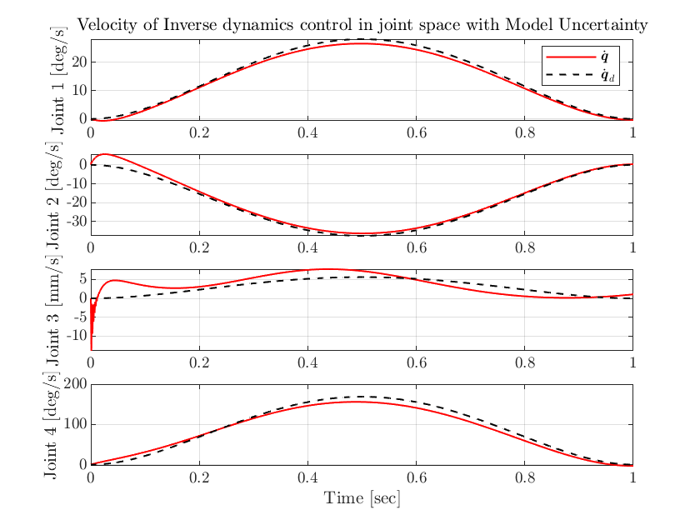


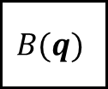











$${\ddot{q}}_{d}$$
$$−$$
$$\dot{\tilde{q}}$$
$$+$$
$$\dot{q}$$
$${\dot{q}}_{d}$$
$$K_{d}$$
$$y$$
$$B(q)$$
$$u$$
Manipulator
$$q$$
$$+$$
$$+$$
$$q_{d}$$
$$\tilde{q}$$
$$K_{p}$$
$$n(∙,∙)$$
$$−$$

Slide 4
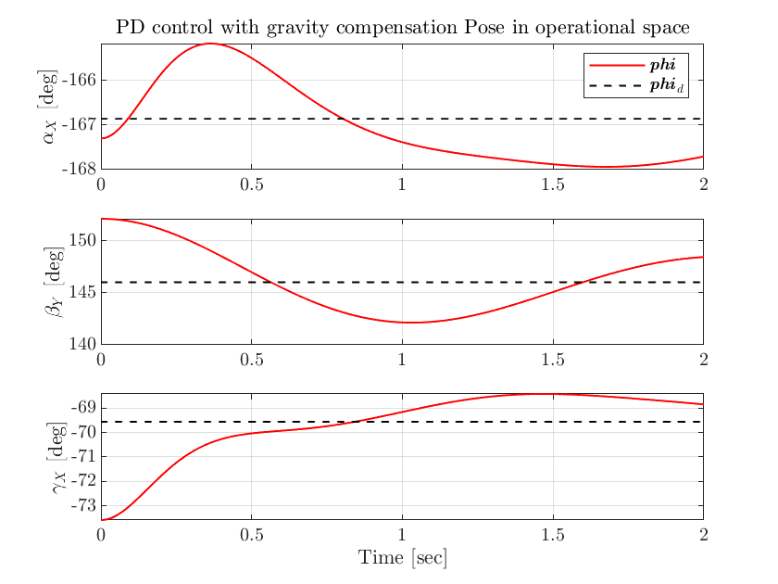
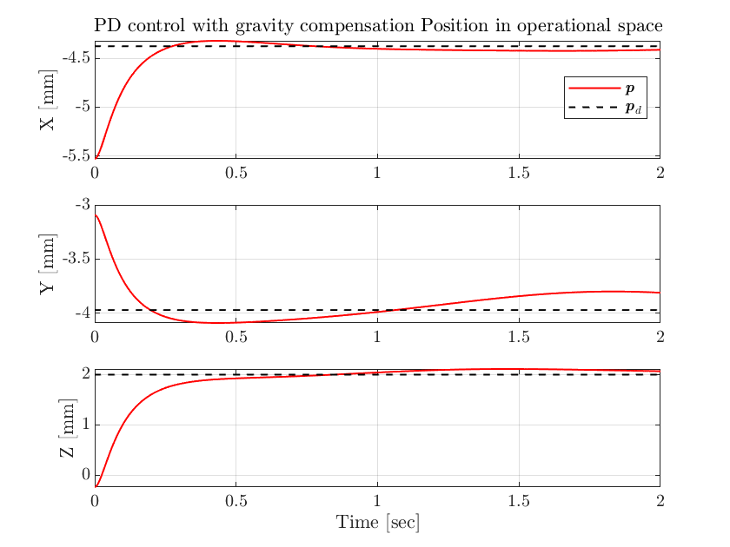
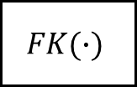


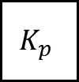





$$K_{d}$$
$$J_{A}(q)$$
$$x_{d}$$
$$\tilde{x}$$
$$−$$
$$u$$
$$\dot{q}$$
$$K_{p}$$
$$J_{A}^{T}(q)$$
Manipulator
$$q$$
$$−$$
$$+$$
$$g(∙)$$
$$FK(∙)$$

Slide 5
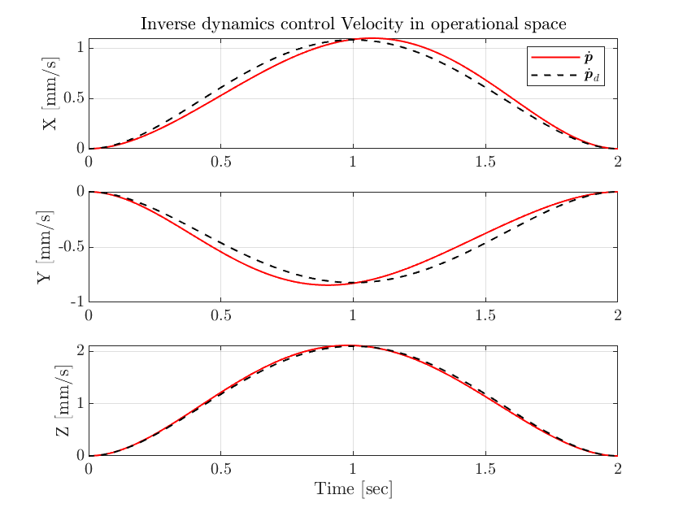
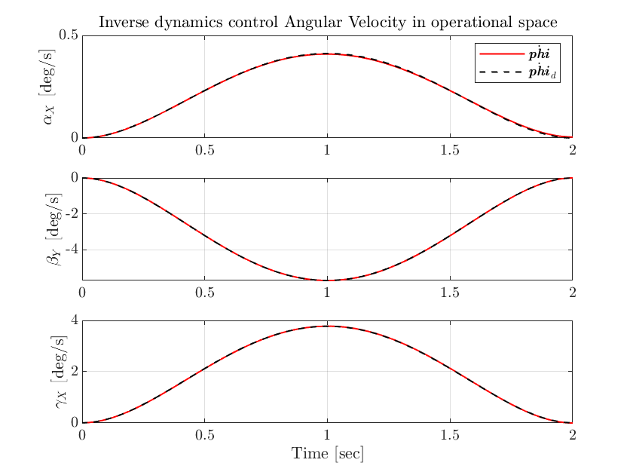
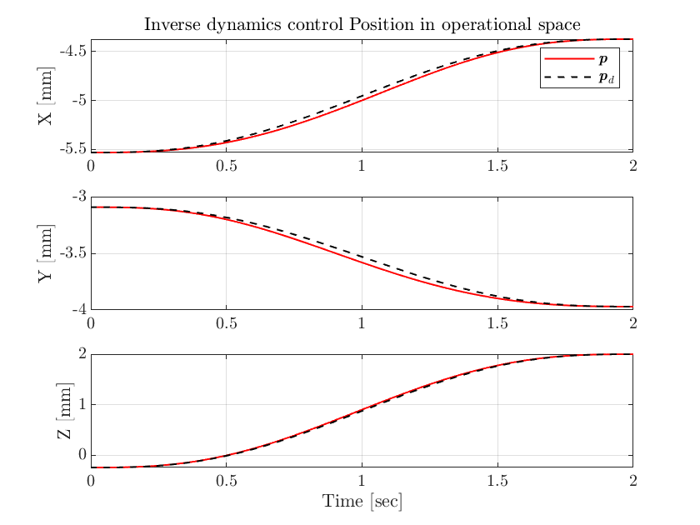
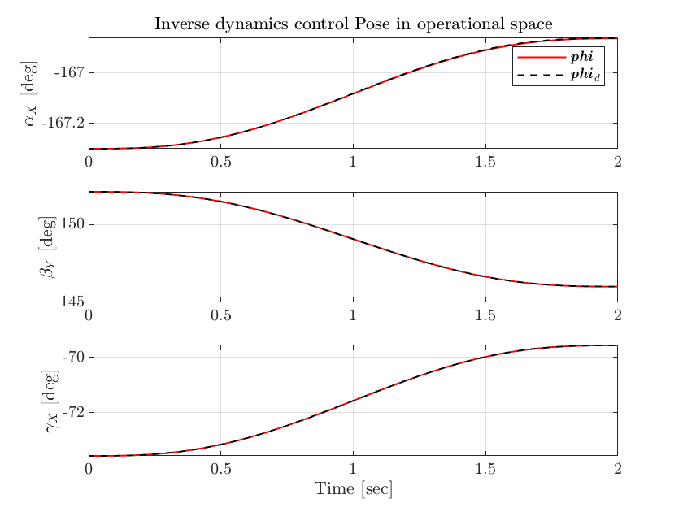
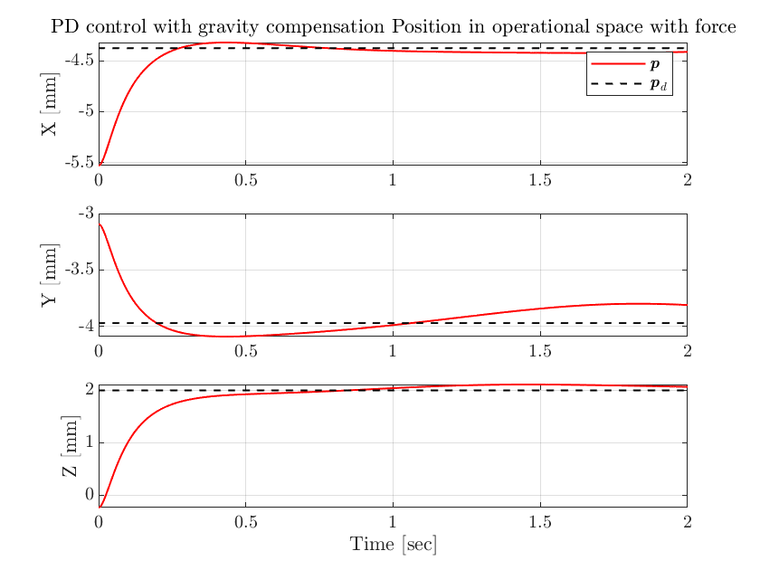


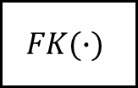



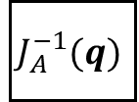










$${\ddot{x}}_{d}$$
$$J_{A}(q)$$
$$−$$
$$\dot{\tilde{x}}$$
$$+$$
$$\dot{q}$$
$${\dot{x}}_{d}$$
$$K_{d}$$
$$J_{A}^{−1}(q)$$
$$y$$
$$B(q)$$
$$u$$
Manipulator
$$q$$
$$+$$
$$−$$
$$+$$
$$x_{d}$$
$$\tilde{x}$$
$$K_{p}$$
$$n(∙,∙)$$
$$−$$
$${\dot{J}}_{A}(q,∙)$$
$$FK(∙)$$

Slide 6
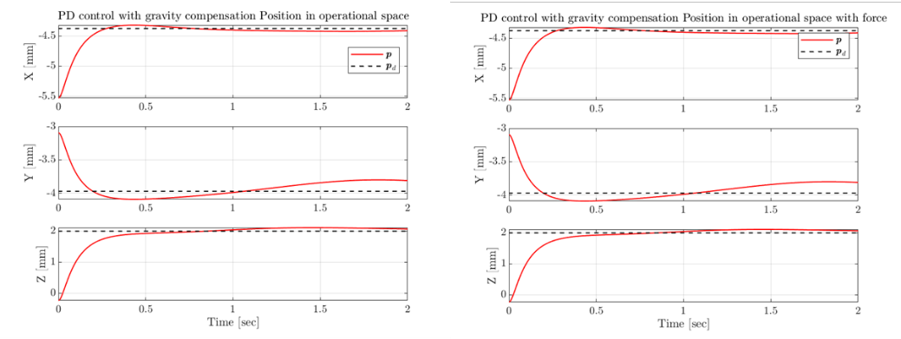
Figure 12: PD control with gravity compensation Matlab simulate without force and with -1000 N external force along z-axis.
For the previous controllers, no matter how much the force exerted on the robot, the robot will keep moving to the exact desired location. In some circumstance, this is quite dangerous, which can hurt people or damage the environment. Therefore, we want the robot can interact with the environment, and response to the external forces.

